Slide 1
PoLyGeAr™
POLYMERIC SPROCKETS, GEARS AND PULLEYS
A NEW APPROACH
PoLyGeAr™

Slide 2
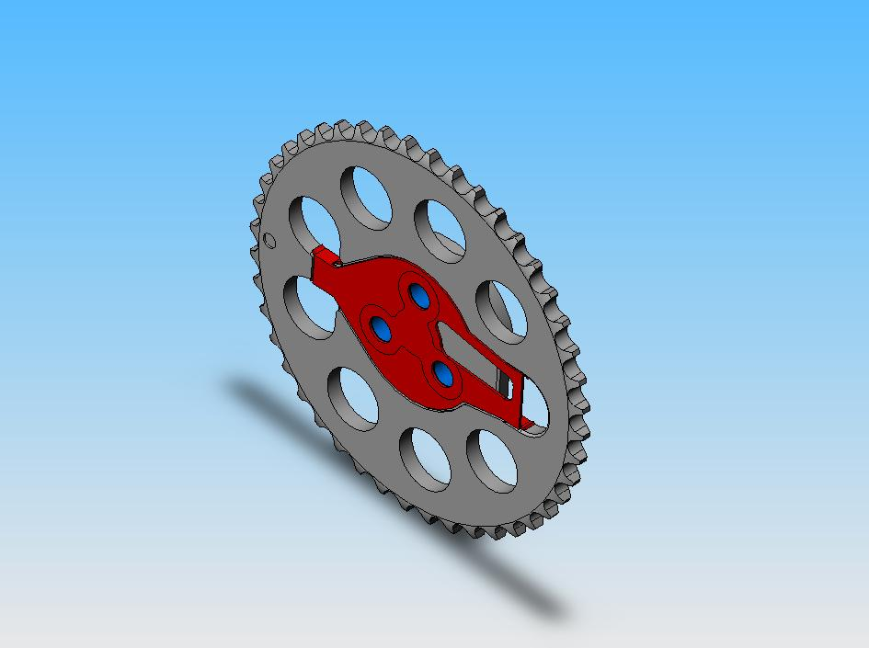

Slide 3
PoLyGeAr Solutions
Reduced
Mass
Noise
Reduction
Advantages
Lower
Cost
Adaptable
Reduced
System
Shock

Slide 4
Polymeric Gear History
Previous polymeric gears, pulleys and sprockets have been plagued by misunderstanding of the characteristics, properties and performance of polymeric materials.
Perhaps the most serious flaw of previous designs has resulted from the distrust of the polymer, and the resulting effort to compensate for the perceived shortcomings.

Slide 5
Efforts to compensate for perceived weaknesses in polymeric materials have often led to designs that were virtually sure to fail.
One of the most frequent is the “over-reinforcement” of the polymeric device through the use of metal inserts.
These inserts are very stiff, and usually prevent the polymer from spreading loads through elastic load displacement.

Slide 6
Polymer sprocket and gear failures most often involve one or more of the following factors:
High static stress
Asymmetrical thermal expansion/contraction
Load concentration
Improper material selection
All of these problems are the result of flaws in component and process design

Slide 7
High static stresses caused by molding a polymer over a stiff metal insert, where shrinkage of the polymer leaves extremely high stresses “molded in”
Asymmetrical thermal expansion and contraction between the metal insert and the molded polymer, resulting in high cyclic stresses during temperature cycling
Extreme concentration of loading as a result of the stiff metal insert
Improper material selection negates significant potential advantages

Slide 8
The Solution:
PoLyGeAr™ represents a novel approach that uses polymeric materials appropriately
PoLyGeAr™ takes advantage of the elastic qualities of polymeric materials, utilizing the elasticity to reduce concentration of loads by allowing elastic load displacement

Slide 9
*
PoLyGeAr™ cam sprockets are one embodiment of the principles that make PoLyGeAr™ power transmission components capable of replacing metal components and adding several significant advantages

Slide 10
Advantages
Light Weight
Noise Reduction
Reduction of system shock loading
Adaptability
Lower Cost

Slide 11
Current Problems
Polygear Solutions
Components too Heavy?
Excessive sound generation?
Excessive shock loading?
Excessive adaptation requirements to accommodate new component?
High system cost?
Reduced
Mass
Noise
Reduction
Advantages
Lower
Cost
Adaptable
Reduced
System
Shock

Slide 12
Lower Cost
PoLyGeAr™ components can be 10% to 40% less expensive than the steel components they replace
Savings can be multiplied by taking advantage of the multifunctional design opportunities made possible with polymeric components

Slide 13
Reduction of System Shock Loading
The elasticity of the polymeric material allows the PoLyGeAr™ component to reduce the system shock loading. In an engine, shock loading is often several times as great as the average static loading
The deflection attendant with this absorption amounts to a fraction of a degree, insignificant for purposes of timing
Reduction can be as great as 80% in a typical push-rod engine without tensioners
The use of a patented Outsert™ allows precise control of elasticity

Slide 14
Adaptability
PoLyGeAr™ is adaptable to virtually any application.
The Outsert™ can be customized to virtually any kind of mounting: Bolts through face, single center bolt, splined, keyed or interference (pressed)
The Outsert™ allows adjustment of the elasticity to whatever level is desired for the application

Slide 15
Testing and Validation
A representative sprocket assembly was produced and installed in an engine
The engine was mounted on a dynamometer and was run with cycling from idle to full throttle (5400 RPM) and immediately back to idle
Engine temperatures (measured as oil temperature) were held at or above normal operating temperatures (~250-260 F)

Slide 16
*
After 100 hours of this cycling, with engine temperatures maintained, the engine was subjected to approximately 12 hours of similar cycling, but with deceleration from 5400 RPM to idle at a rate of over 1000 RPM per second in order to simulate a “worst case” shock loading condition

Slide 17
*
At the end of the test, the sprocket was examined and photographed. No adverse conditions were found. The following are photographs of the installed sprocket after the dynamometer testing

Slide 18
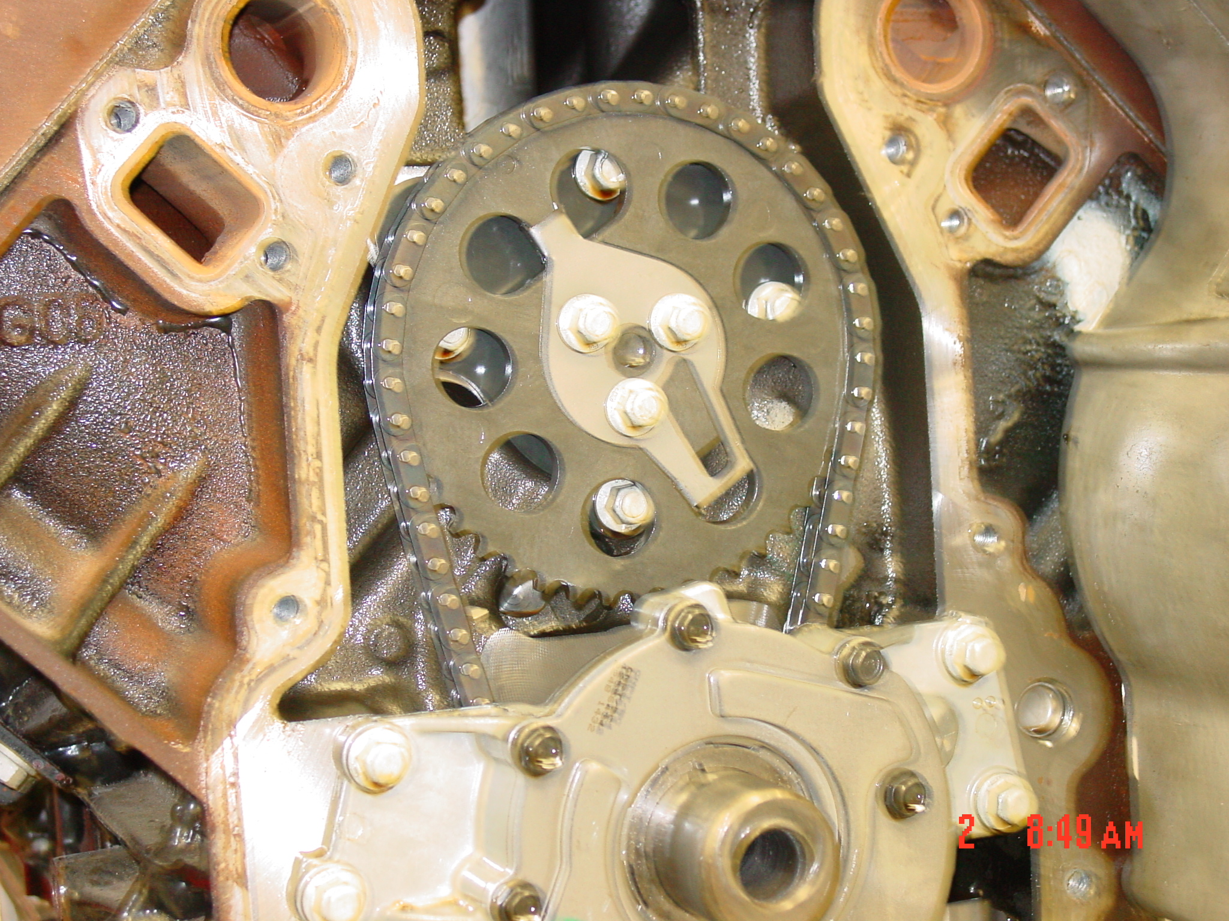

Slide 19
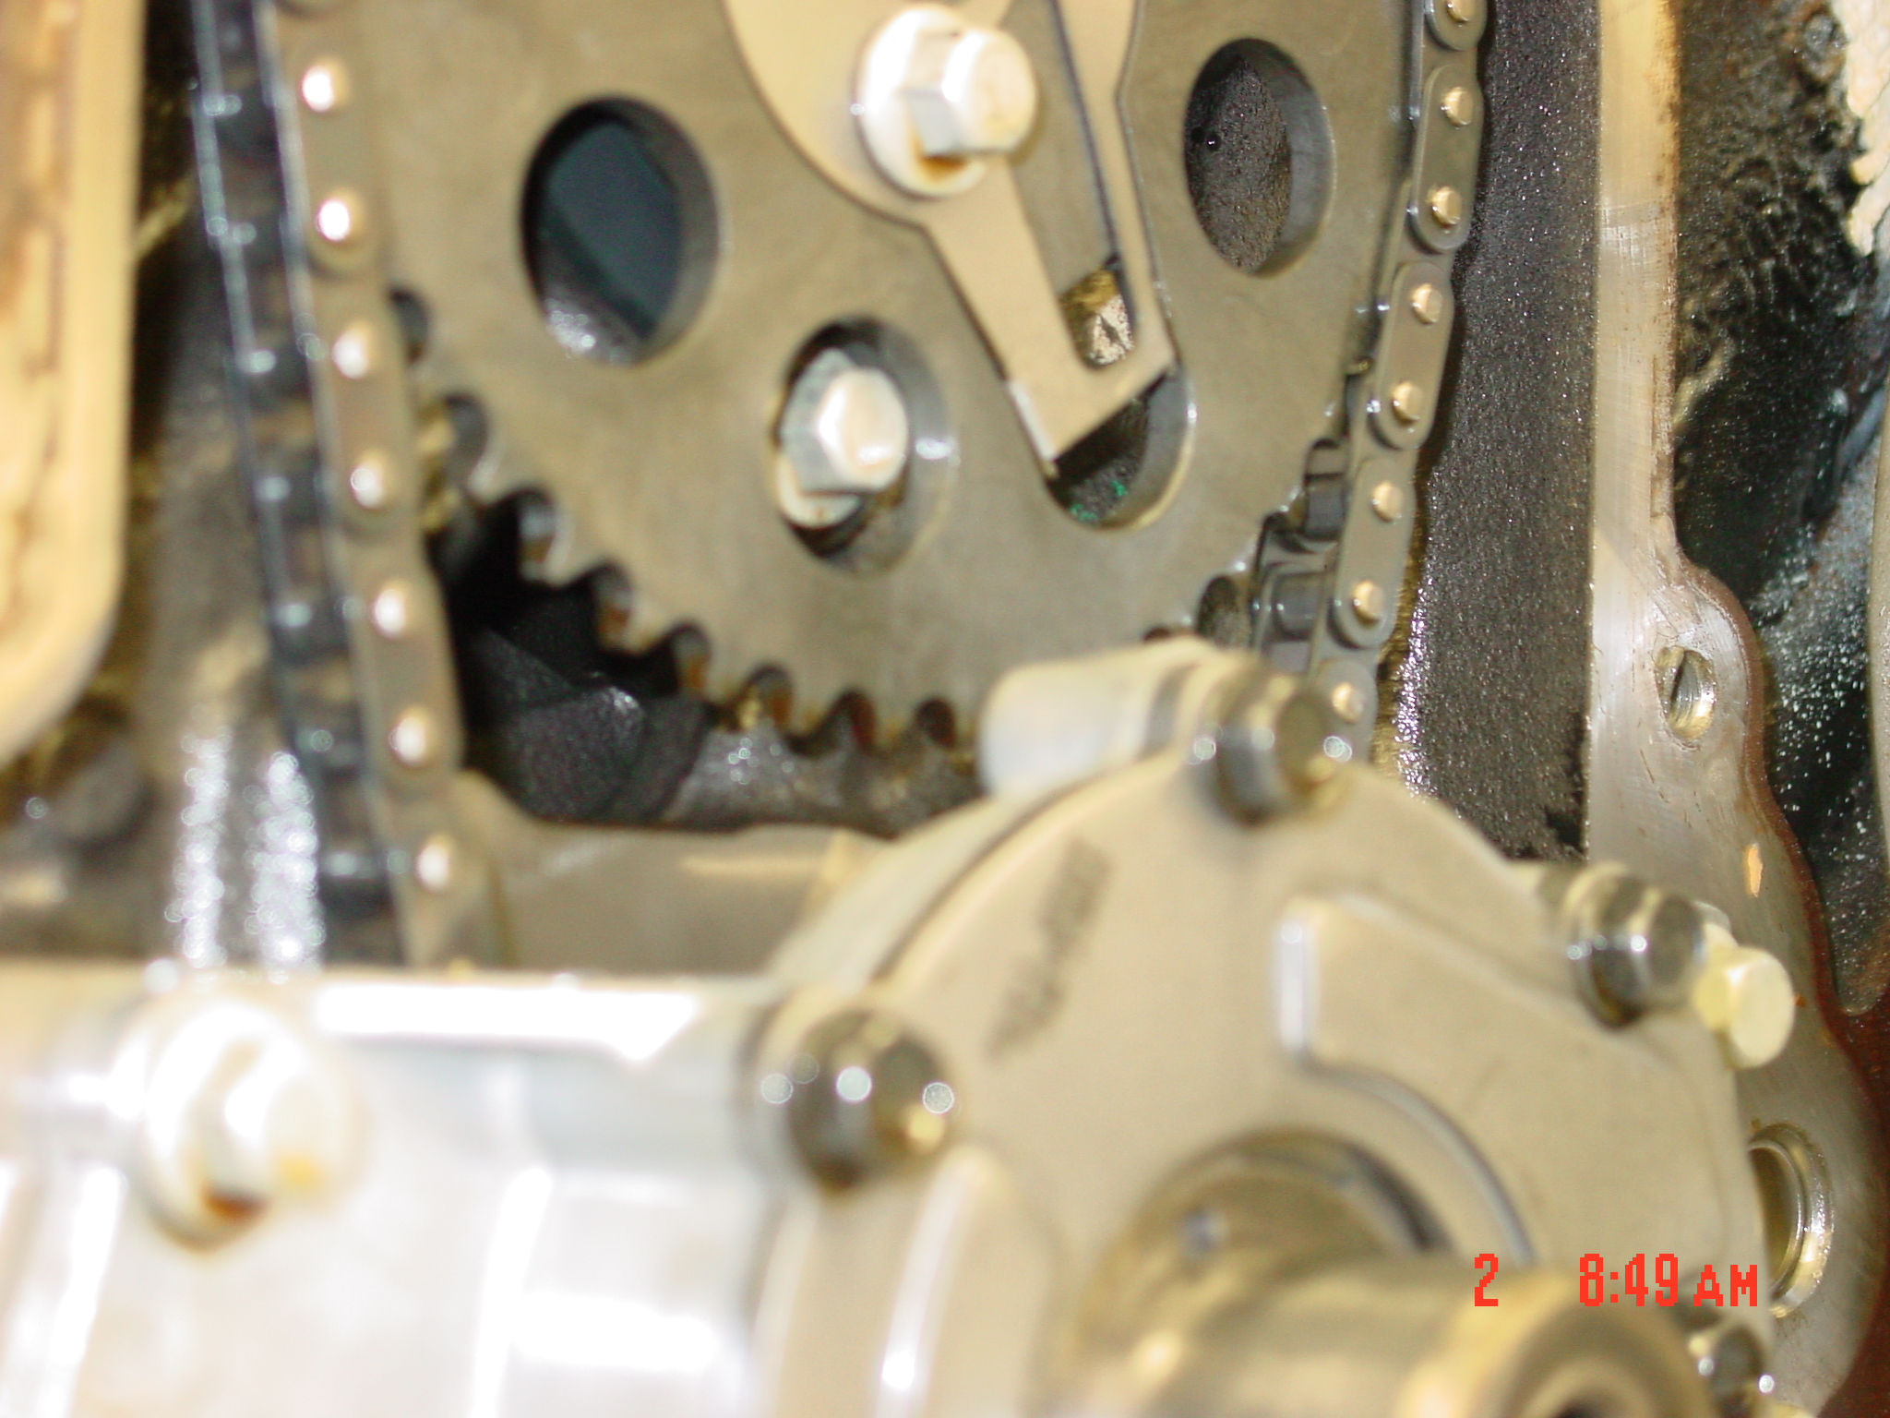

Slide 20
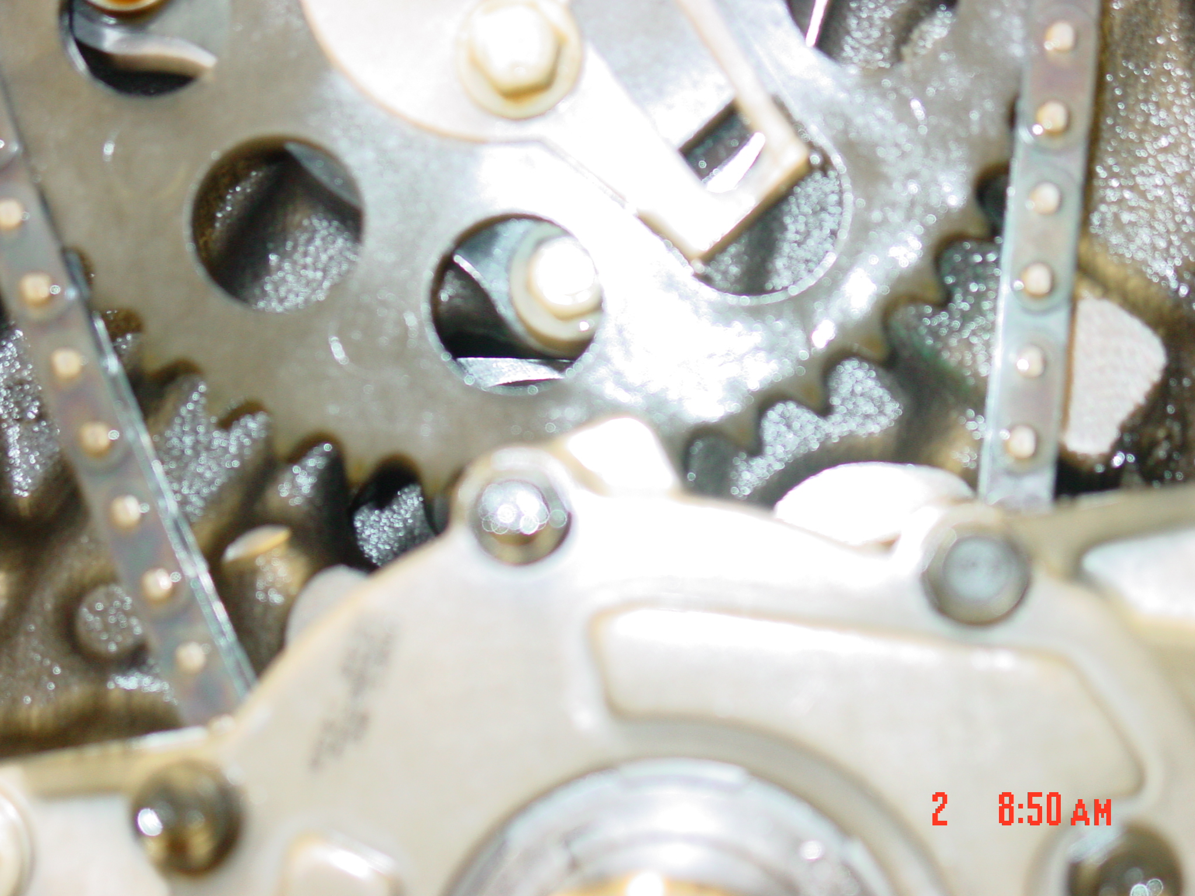

Slide 21
***
After the dynamometer testing, the engine was installed in a vehicle that was driven about 160,000 miles. After the first 30,000 miles, the sprocket was removed for evaluation, and showed no signs of wear, cracking, distortion or any other signs of compromise.

Slide 22
***
The following photographs were made at the 30,000 mile evaluation. There is no evidence of wear, distortion, creep or any other compromise of the sprocket after the dynamometer testing and 30,000 miles of road testing. Road testing has included over 12,000 miles of trailer towing, 1,800 miles of which involved temperatures over 100 F ambient.

Slide 23
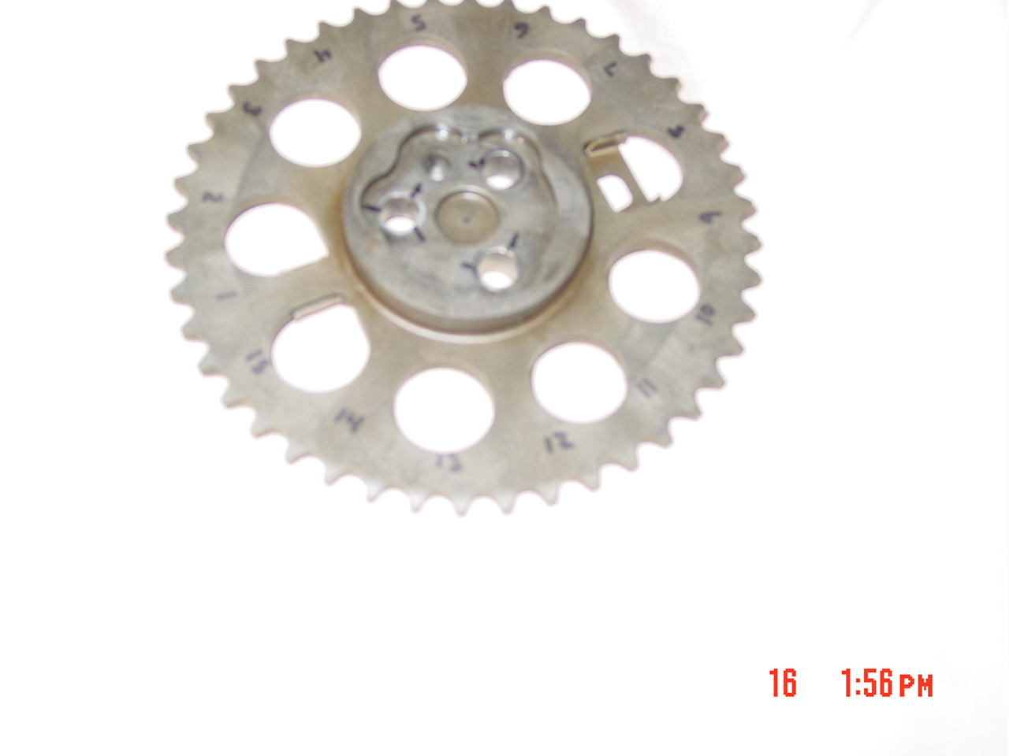

Slide 24
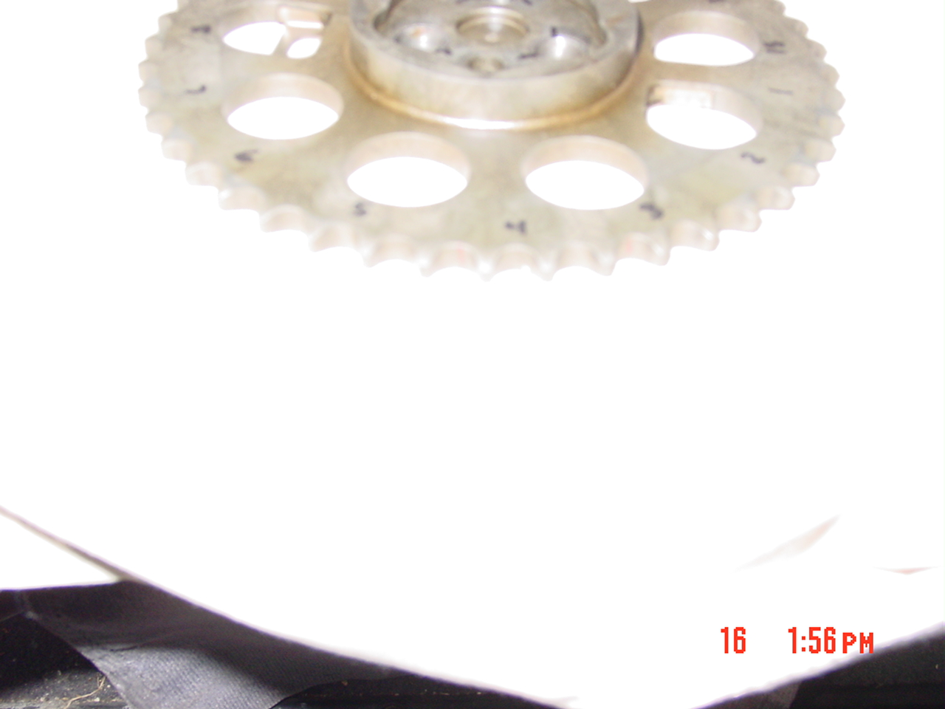

Slide 25
***
The solid models show the basic design of the sprocket. The exploded view shows the compression limiters and Outsert™ prior to mating with the Sprocket.

Slide 27
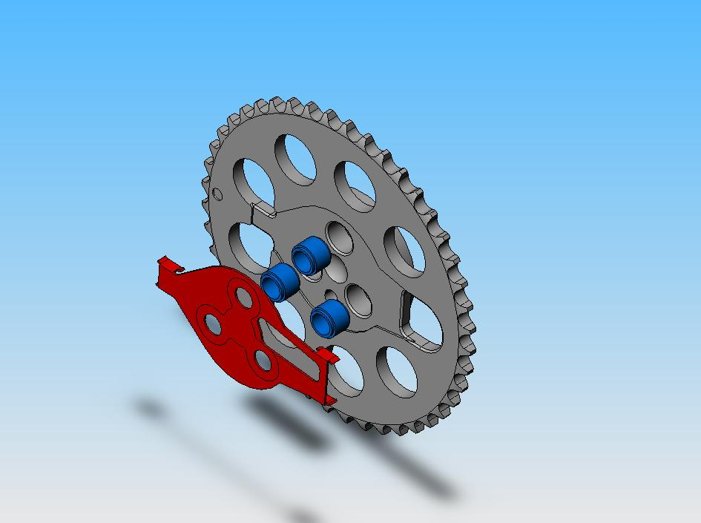

Slide 28
Key Benefits
Shock Absorption | Distributed Loading on Sprocket and Chain | Light Weight
Low Cost | Remarkable Adaptability | Transparent Application

Slide 29
Next Steps
Evaluate advantages in reducing the shock loading which is largely responsible for the excessive lock pin wear.
Establish timeline for testing
Secure Prototype sprocket assemblies for evaluation and testing
Test, evaluate, prepare for pre- production or pilot components and production

Slide 30
PoLyGeAr™
POLYMERIC SPROCKETS, GEARS AND PULLEYS
THE NEXT GENERATION
PoLyGeAr™

